Slide 1
FDIBCP summary

Slide 2
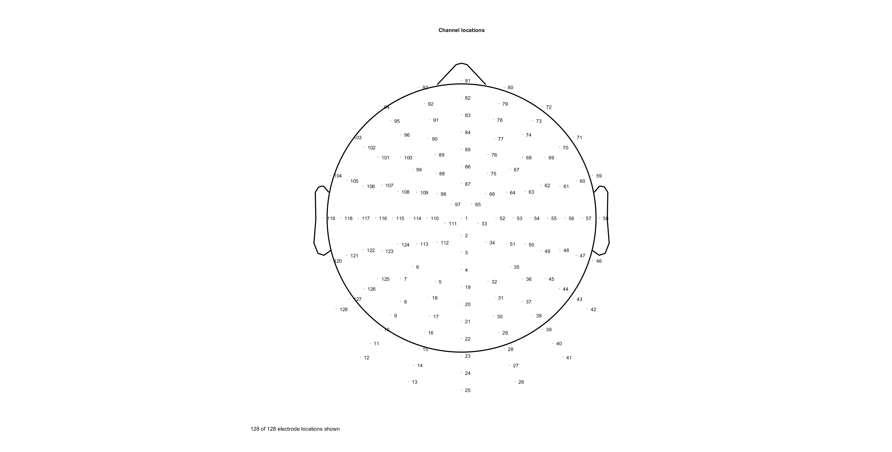


Notes:
FC34L: 108,109, 114,115
FC34R: 63,64, 53,54

Slide 3
Behaviour analysis
SSVEP analysis
CPP analysis
LRP analysis
MB analysis
EMG analysis

Slide 4
accuracy Summary
no clear difference in acc between FDI and BCP 82%
Easy (0.14) has higher ACC 89% vs 80%
no clear difference in acc between left and right hand 82%
RT Summary
correct RT is faster than Wrong RT
BCP is 20-30ms faster than FDI only in correct trials
Low(Hard) slower RT , more symmetric, High(Easy) more left screw;
left is around 80ms (45 correct 120 for wrong) slower than right response (all right hand user)

Slide 5
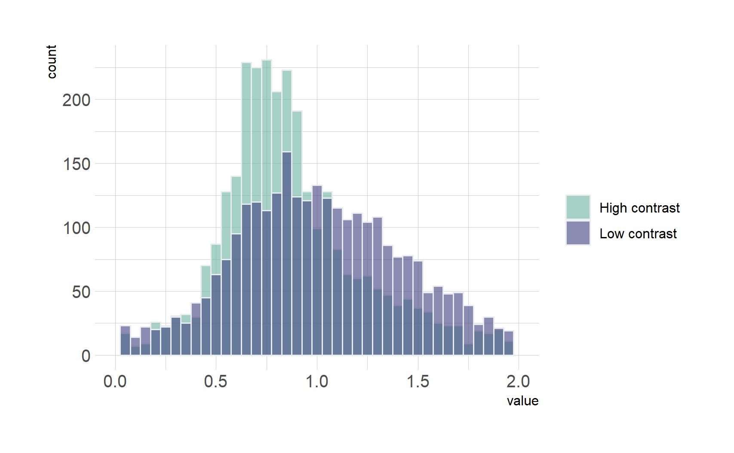
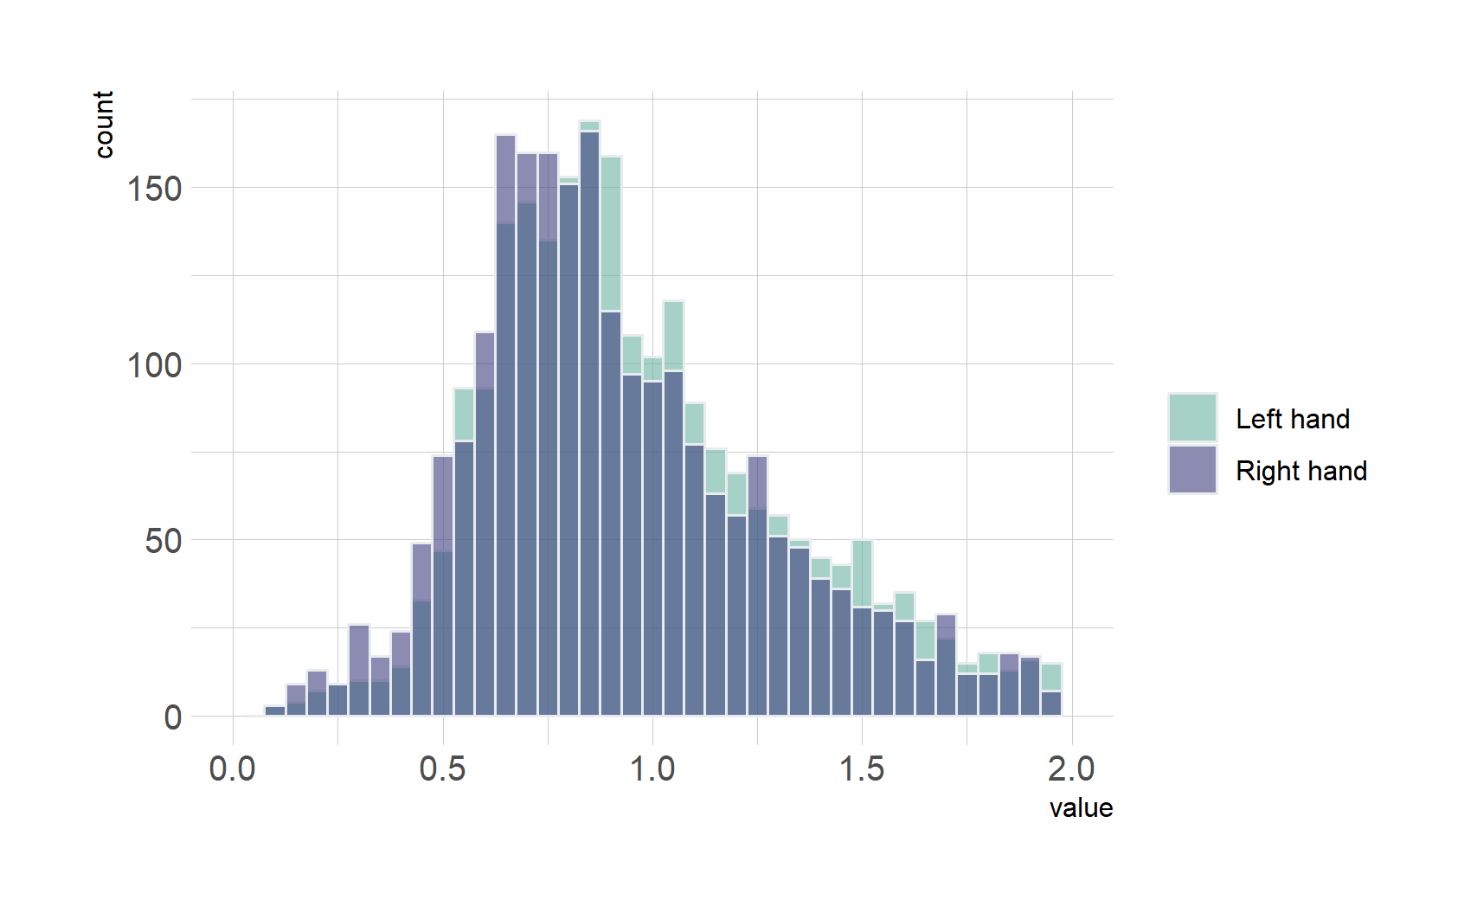
Welch Two Sample t-test data: E_RT_C and H_RT_C t = -12.565, df = 4088.8, p-value < 2.2e-16 alternative hypothesis: true difference in means is not equal to 0 95 percent confidence interval: -0.1541506 -0.1125373 sample estimates: mean of x mean of y 0.8868534 1.0201973
Low(Hard) slower RT , more symmetric, High(Easy) more right screw;
Welch Two Sample t-test data: L_RT and R_RT t = 7.5233, df = 5831.7, p-value = 6.149e-14 alternative hypothesis: true difference in means is not equal to 0 95 percent confidence interval: 0.05844823 0.09964206 sample estimates: mean of x mean of y 0.9717512 0.8927061
Left is around 80ms slower than right (all right hand user)

Slide 6
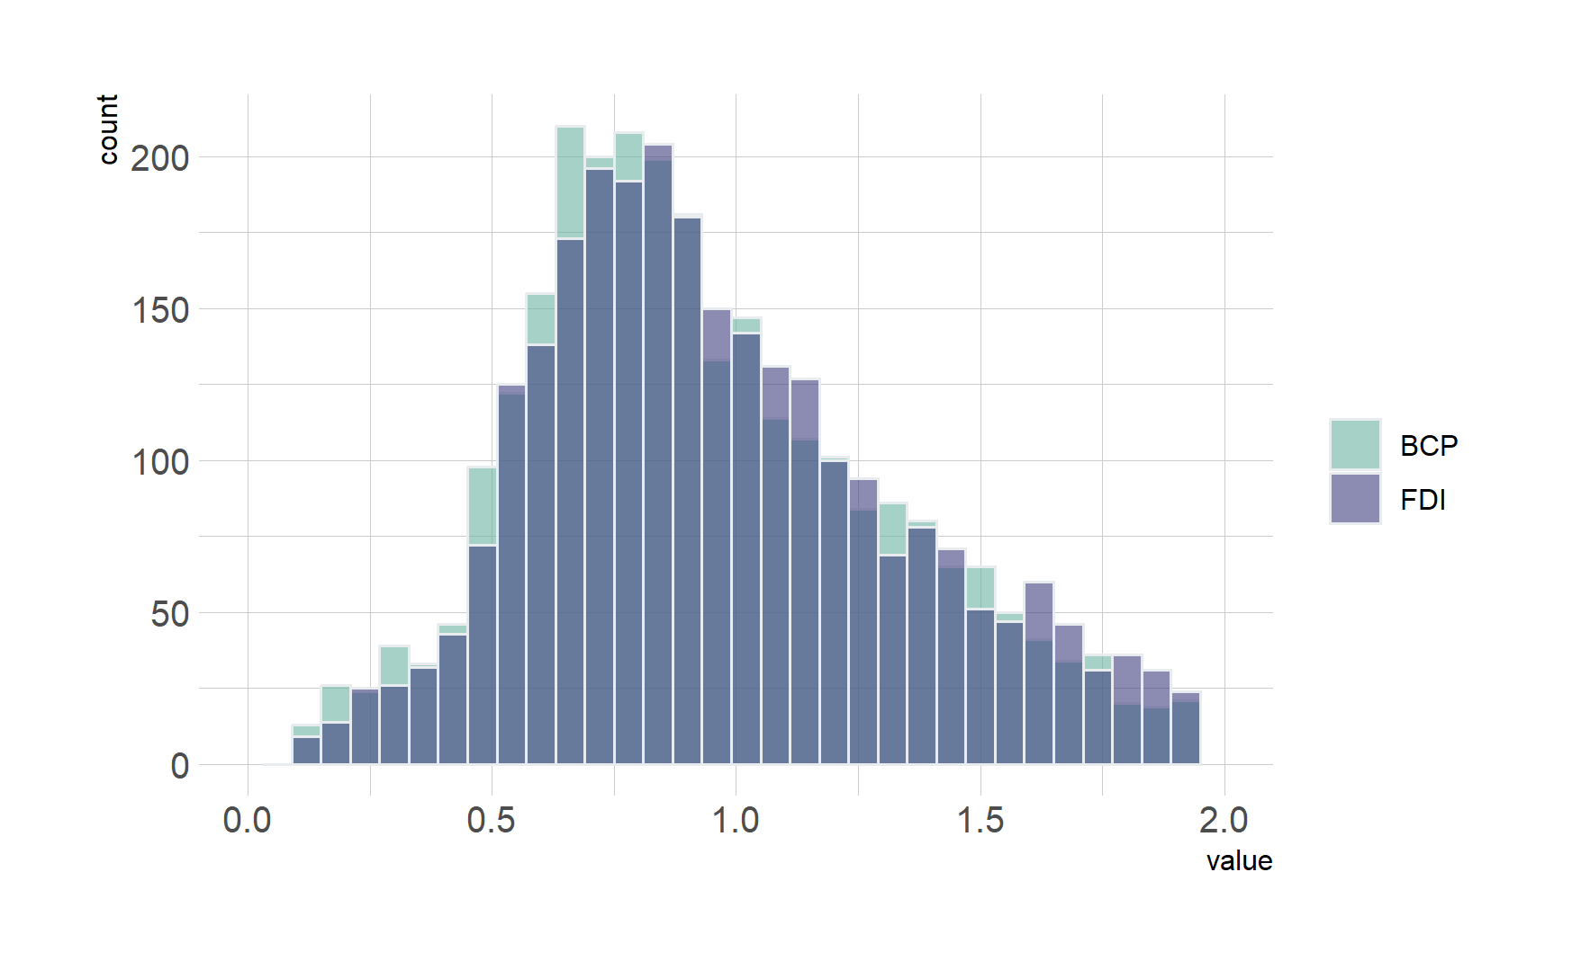
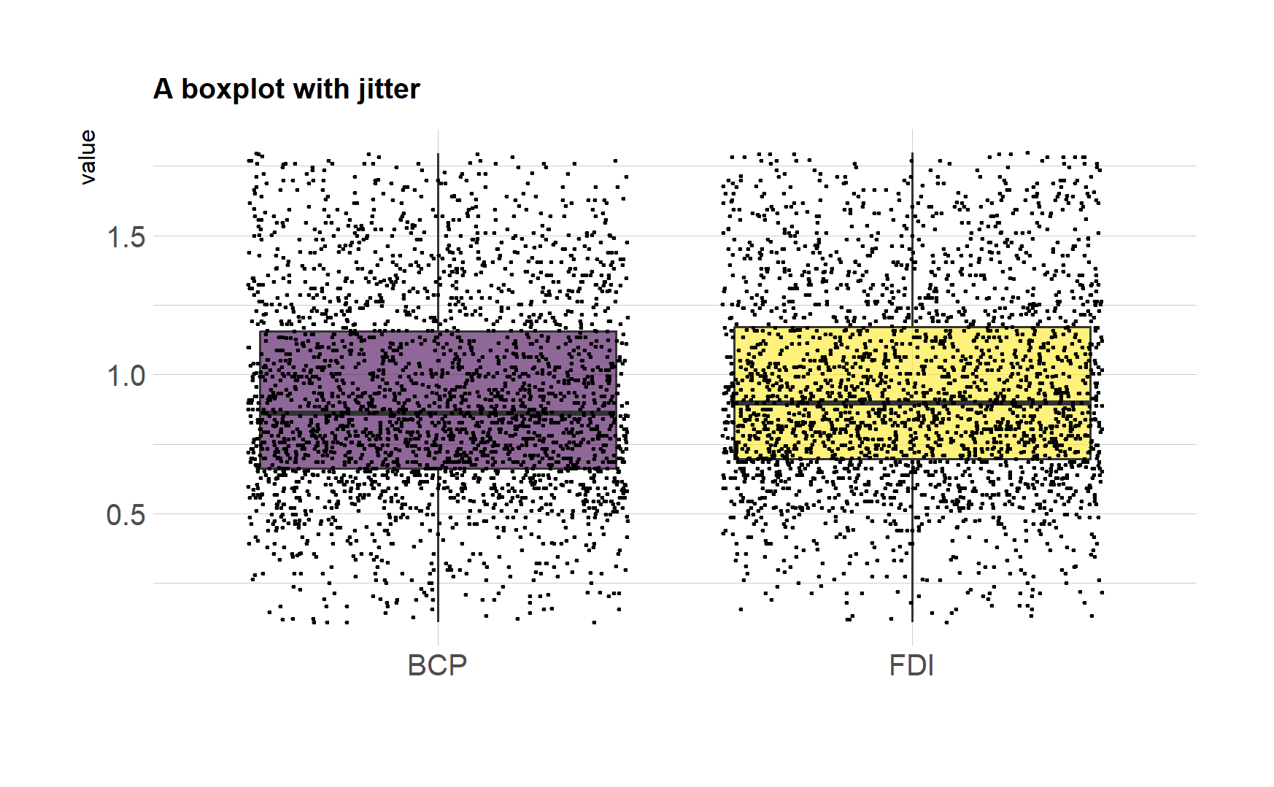
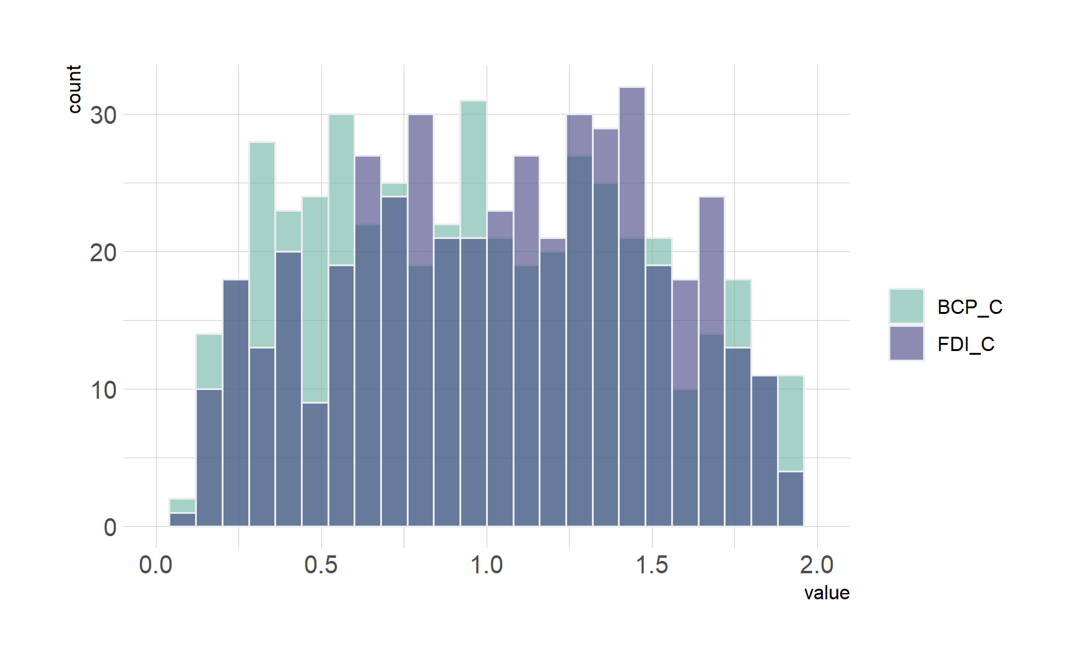
Welch Two Sample t-test data: FDI_RT and BCP_RT t = 2.6998, df = 5343.1, p-value = 0.00696 alternative hypothesis: true difference in means is not equal to 0 95 percent confidence interval: 0.007129105 0.044932677 sample estimates: mean of x mean of y 0.9428334 0.9168025
BCP is 20-30ms faster than FDI in correct and wrong trials

Slide 7
SSVEP

Slide 8
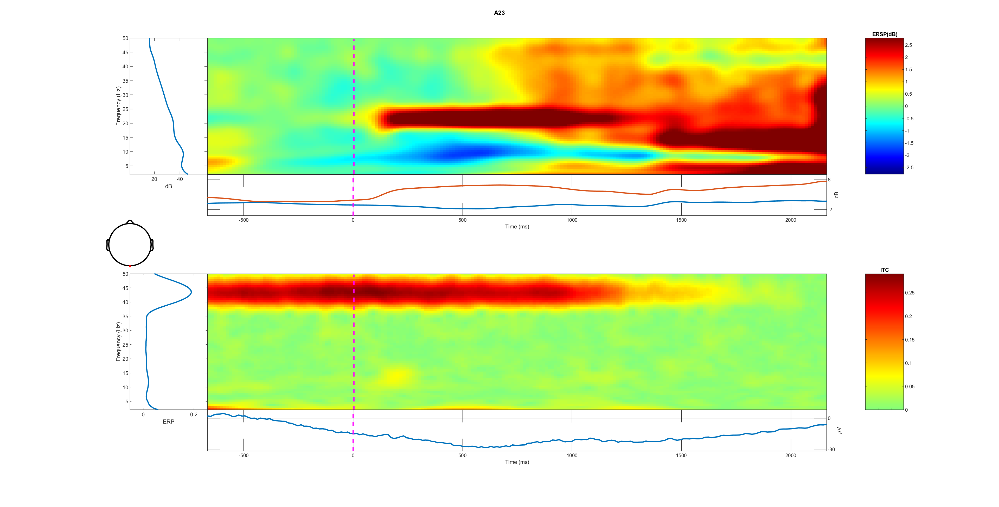
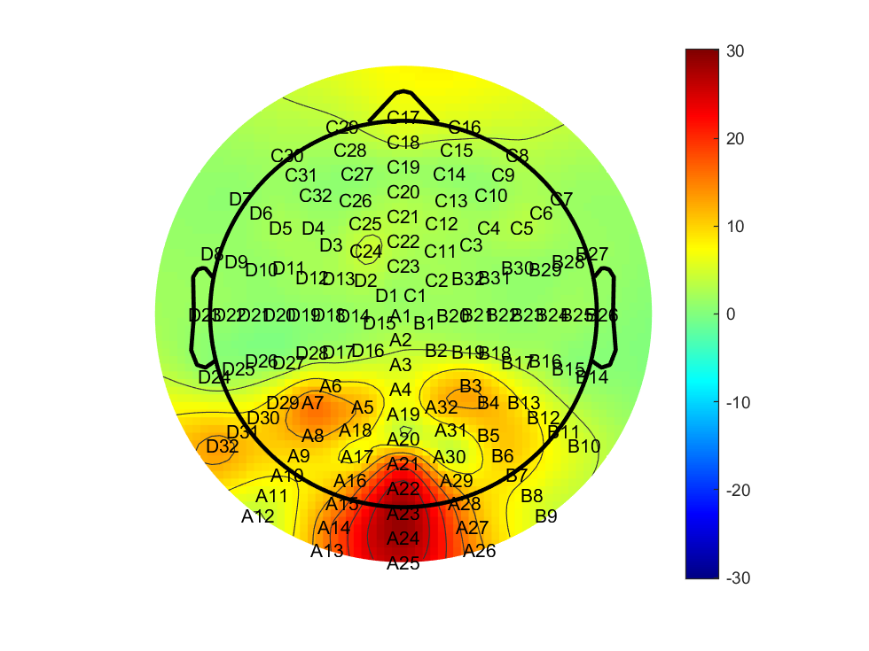
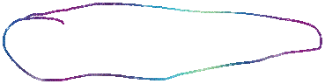
A23 all trail 0-50Hz

Slide 9
Low-1 vs high-2 (correct vs wrong)

Slide 10

BCP (2) slightly higher at first but lower slop, lasting longer FDI higher in the steady stage initial stage different?

Slide 11
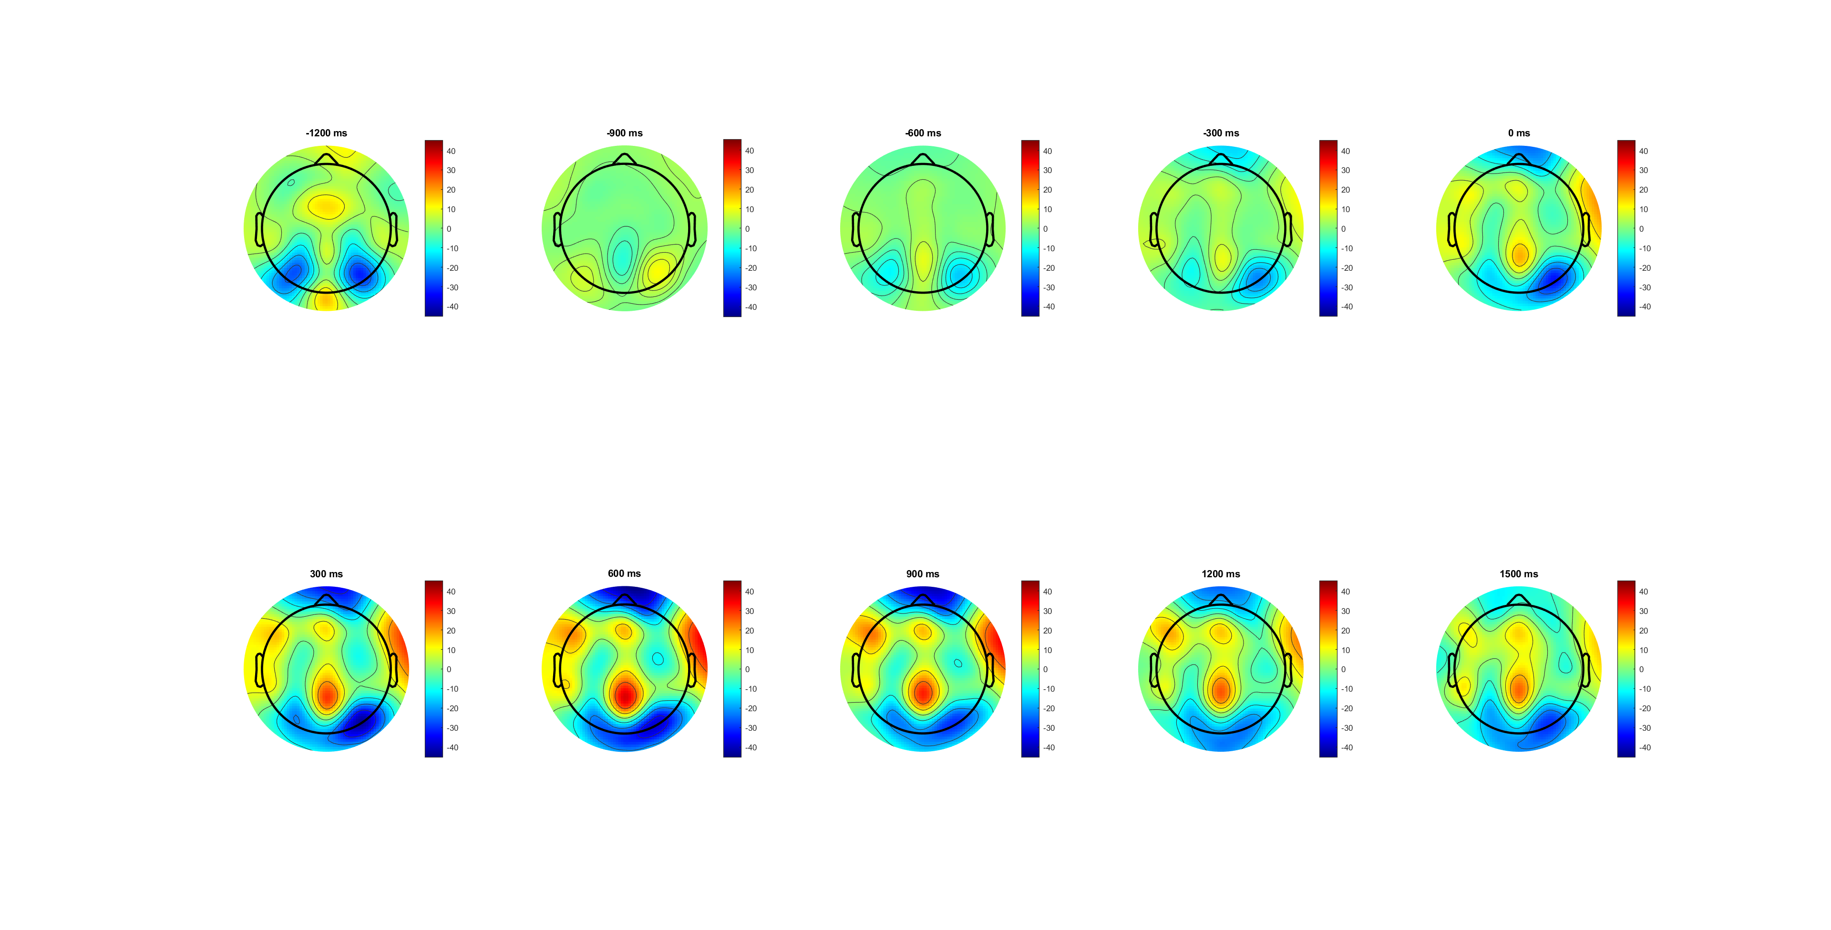
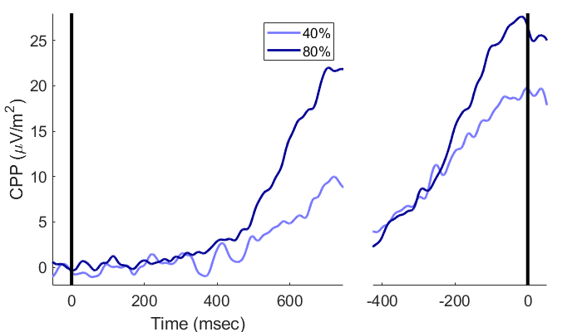
CPP

Slide 12







Slide 13
Notes:
Cue后300开始积累， ev后300出现斜率差异

Slide 14
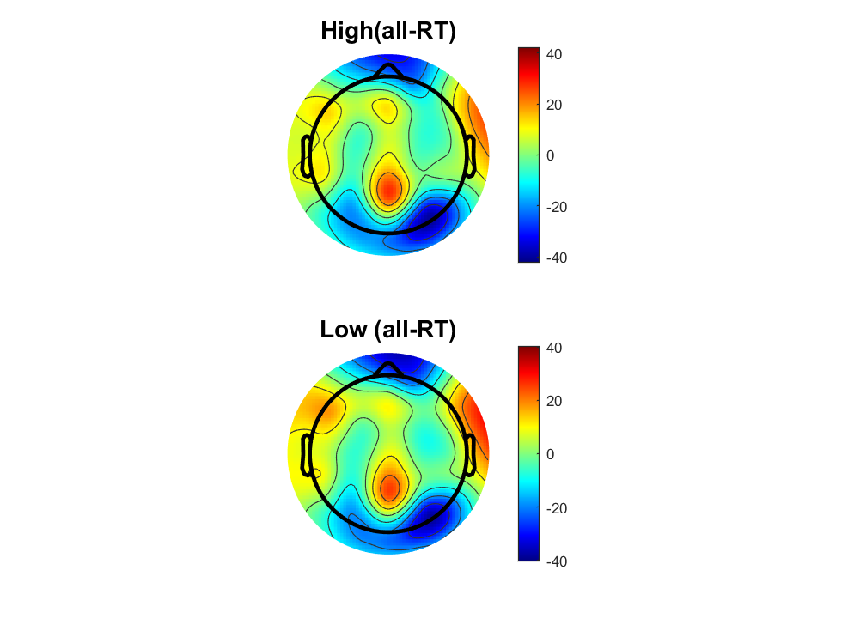
Notes:
H amplitude更大，且L更波动，到达高点后维持更长时间
Q-RT 斜率更大

Slide 15
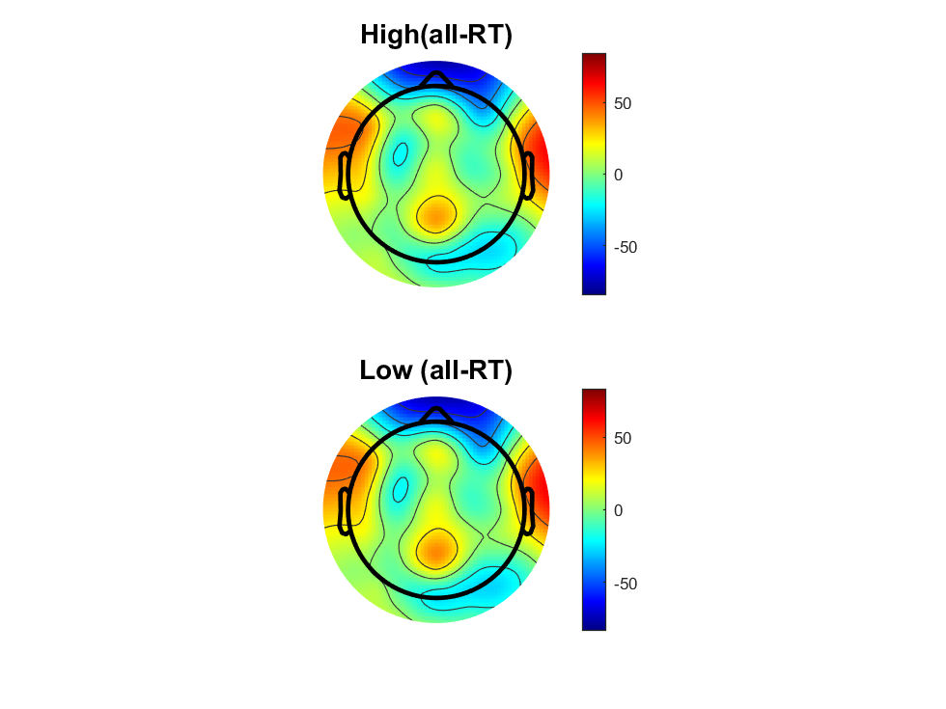
Notes:
L快速应答不足，所以M和Q区别不足

Slide 16

Notes:
EOL的0点更提前，更好的区分MT和PMT

Slide 17
Notes:
SL：斜率不同，BCP阈值更高（假设为线性模型）
RT: BCP斜率更大，所以FDI更快
EOL: BCP有更快的RT(为证明其中加快是来自MT or PMT),需要EoL，
结合行为数据与EOL，似乎BCP更快的RT来源于MT（EMG onsite后的斜率差异， 可能PMT中仍存在（有一种假设是按比例减少），需要更大数据集

Slide 18
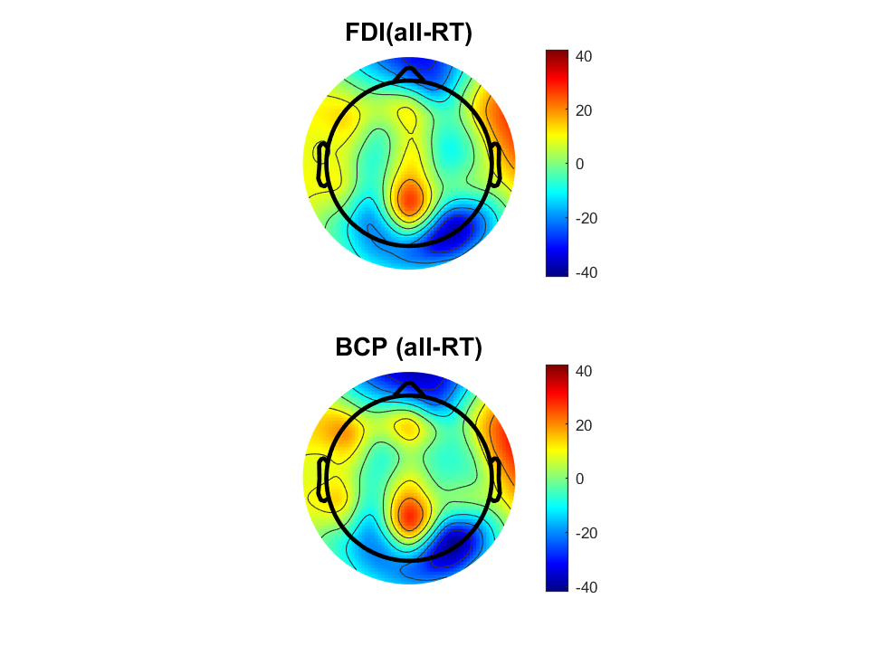
Notes:
FDI三种时间peak相同，斜率不同
BCP三种时间oeak不同。斜率MandS比较晚出现斜率不同

Slide 19

Notes:
FDI三个时间斜率不同
BCP尤其是M和Q,斜率相同，只是发生时间有延后 (暗示触发反馈的神经机制一致，更像线性模型)
S在两个区别不大，可能是缺少了由MT/PMT不同引起的bais，或者单纯注意力不集中的Trial

Slide 20

Notes:
FDI饱和点更集中
BCP最高点出现的时间差异减小（但仍然存在，加入新假设，BCP对于不同反应速度的MT差异更大？）
如果增加数据量，还能在BCP里观察到斜率不同，则两个假设都成立（线性模型+MT时间对于不同RT差异更大（因为更难控制20%的力））

Slide 22
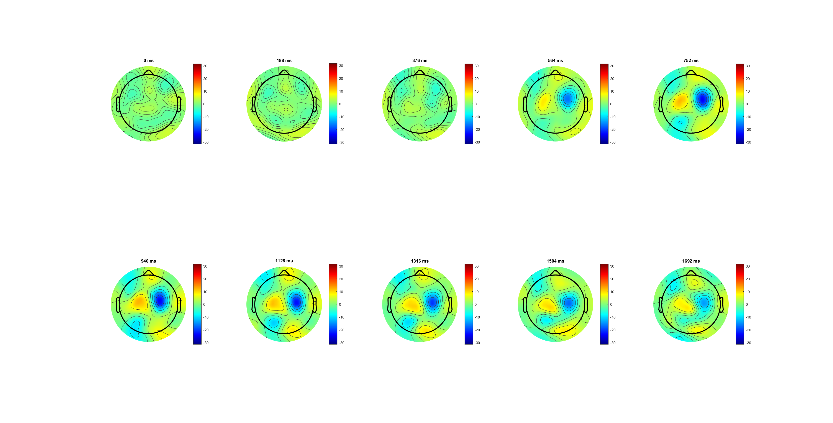
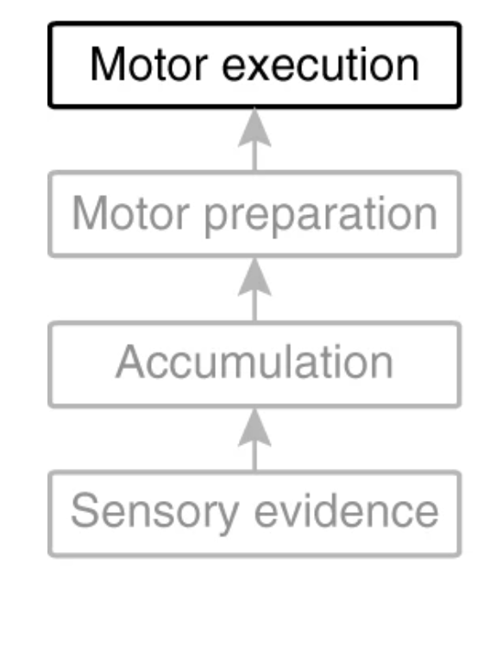
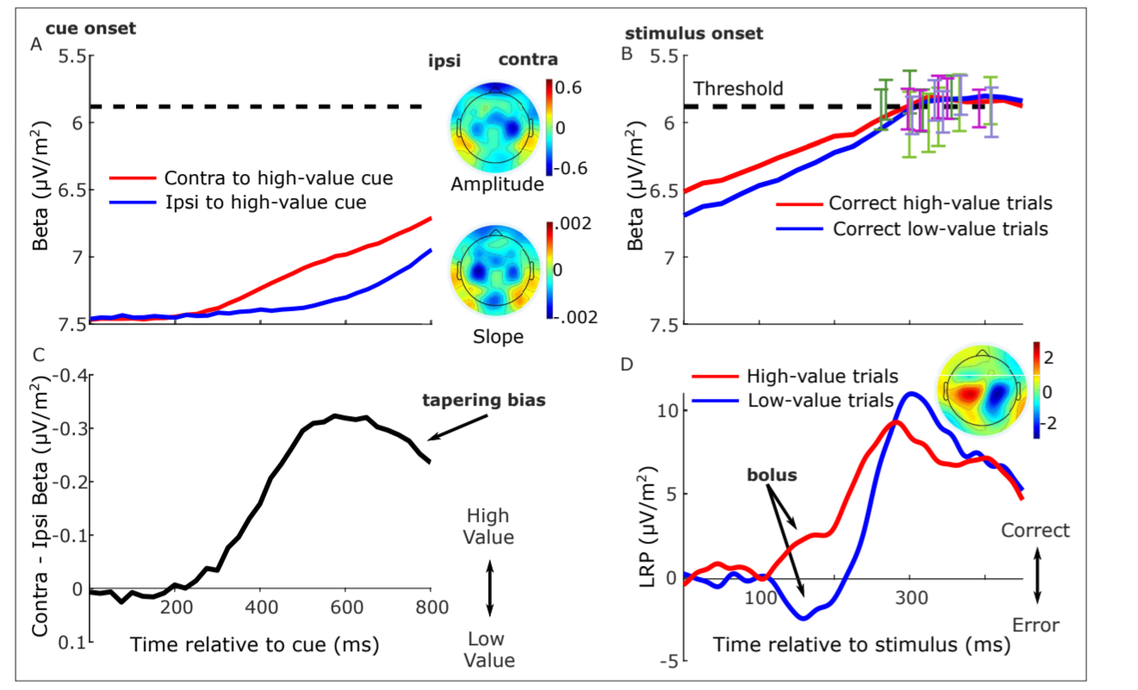
LRP analysis

Slide 24
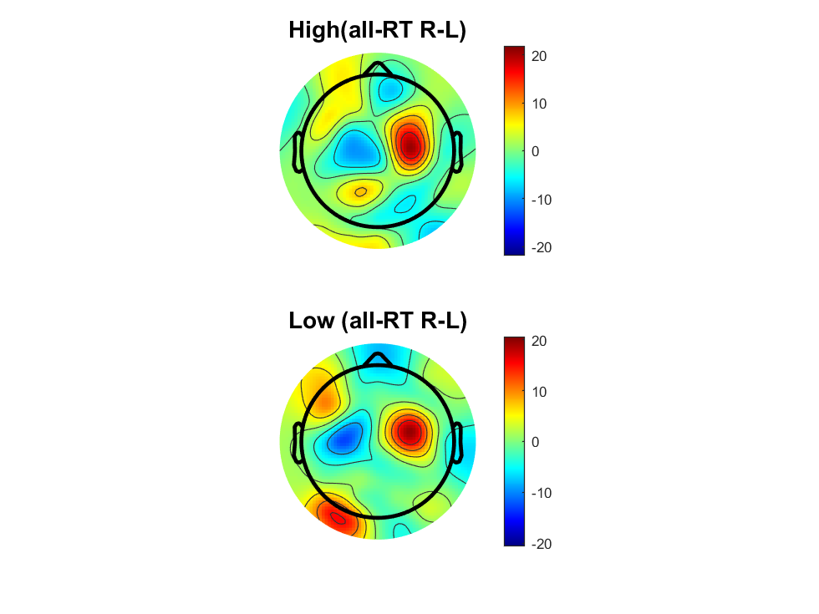

Slide 25
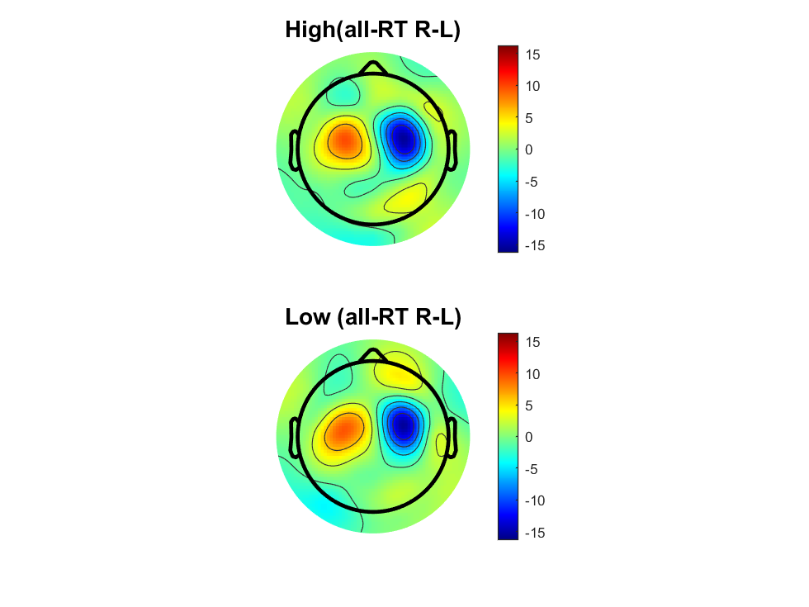

Slide 26
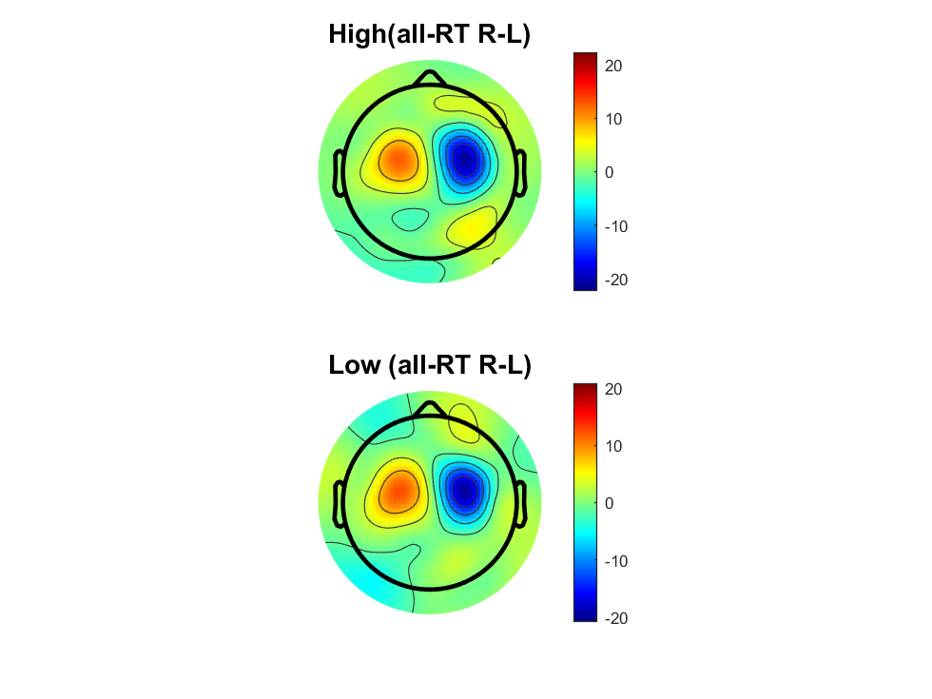

Slide 28
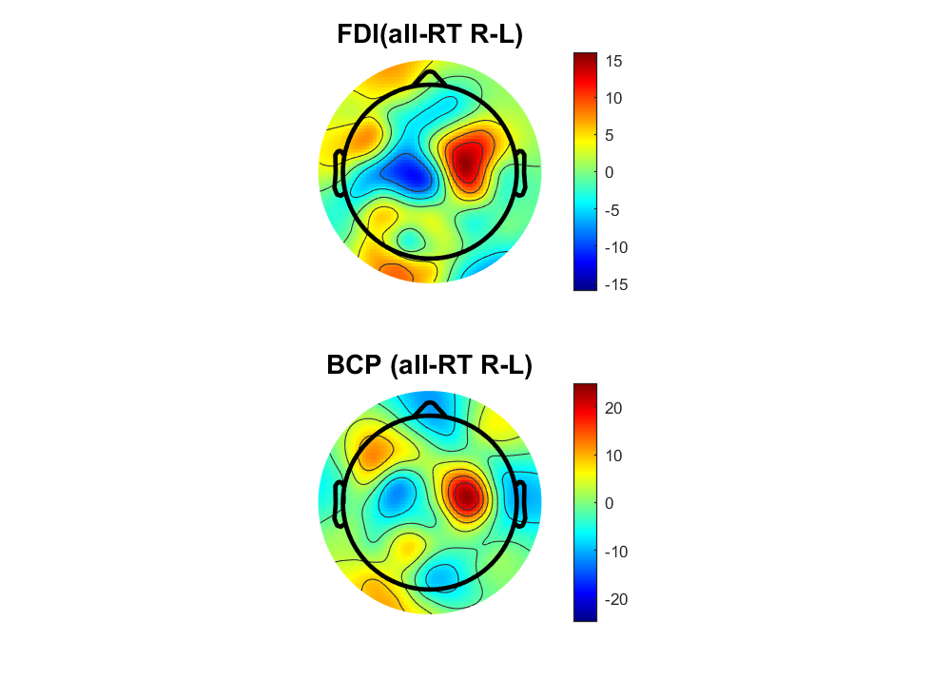

Slide 29
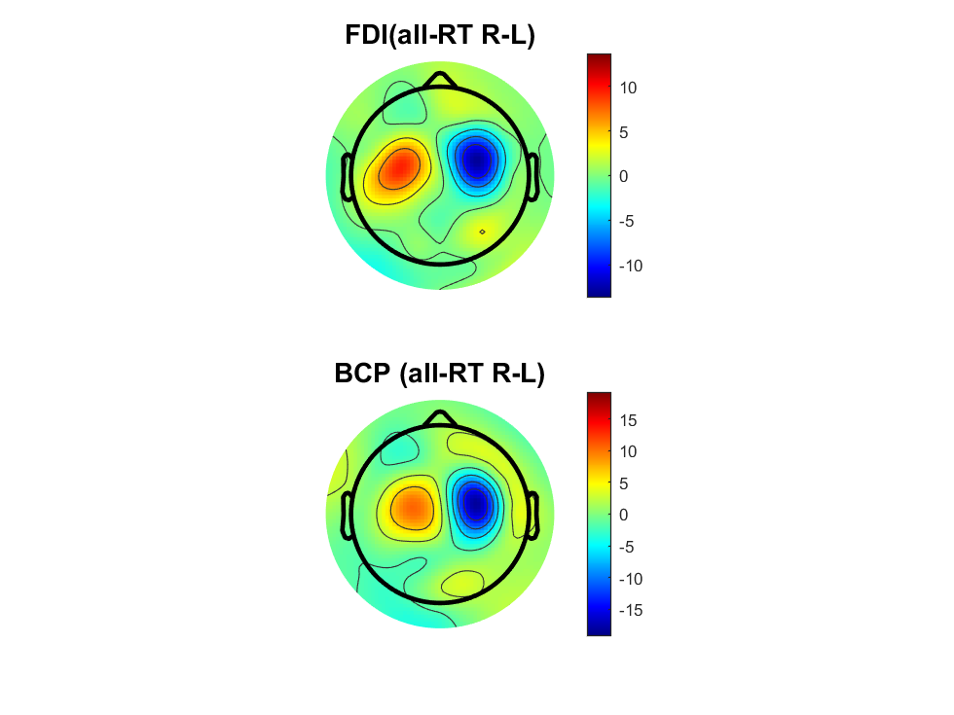
smooth-=10
Notes:
细微位置差异，看终点位置

Slide 30


Slide 31
After evidence on (300ms) shows the diff.
Correct steeper slope
Correct higher amplitude in the end
high 0.14 have higher amplitude
high 0.14 have steeper slope in both increasing and decreasing period

Slide 32
BCP higher amplitude in SL
Same slop
FDI higher amplitude in RL

Slide 33
MB analysis
Wrong and low 0.07 have higher MB amplitude
BCP higher MB amplitude
Location: FDI wider and middle; BCP narrower and frontal

Slide 34
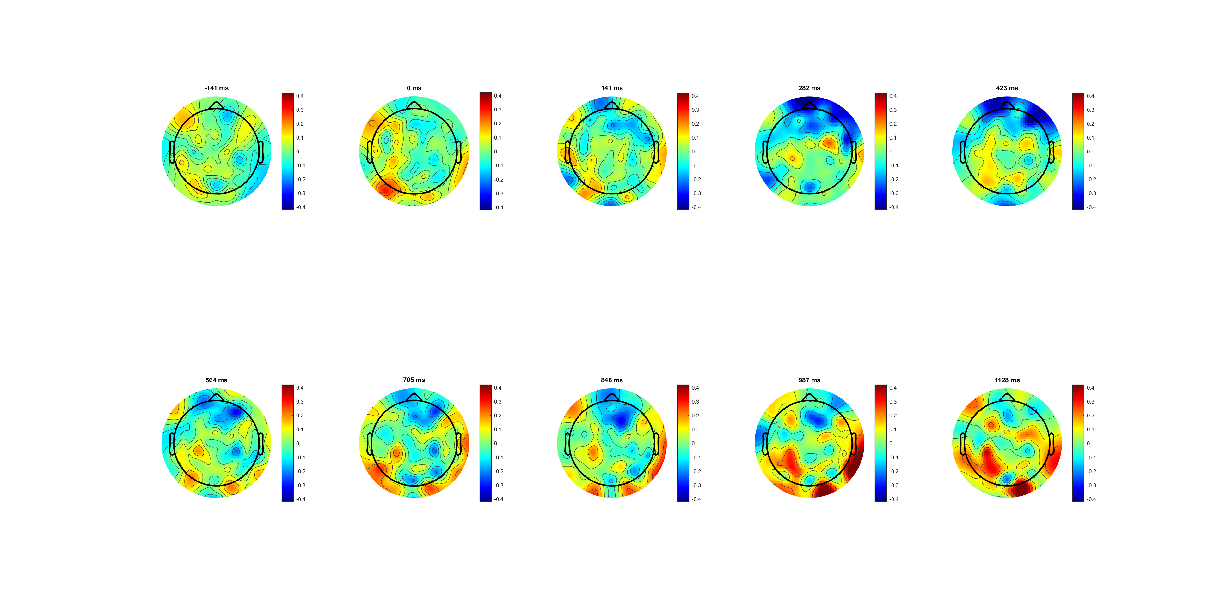


Correct lateralisation (L-R) 0.4limit

Slide 35
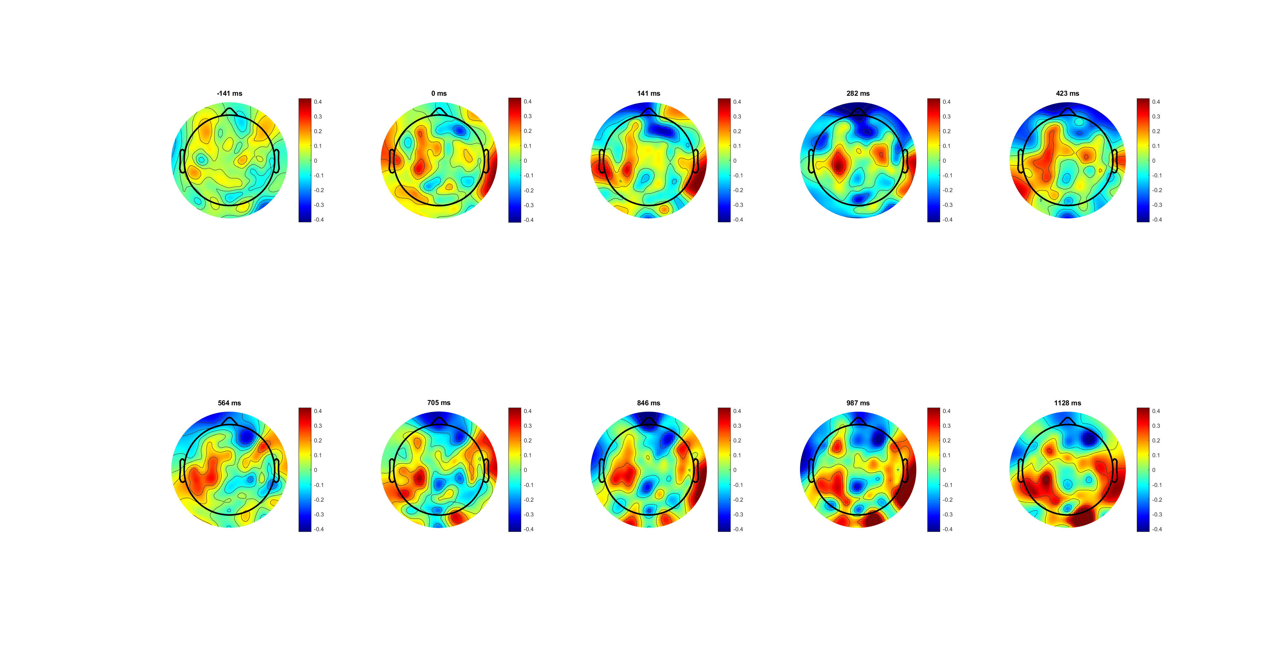



Slide 36
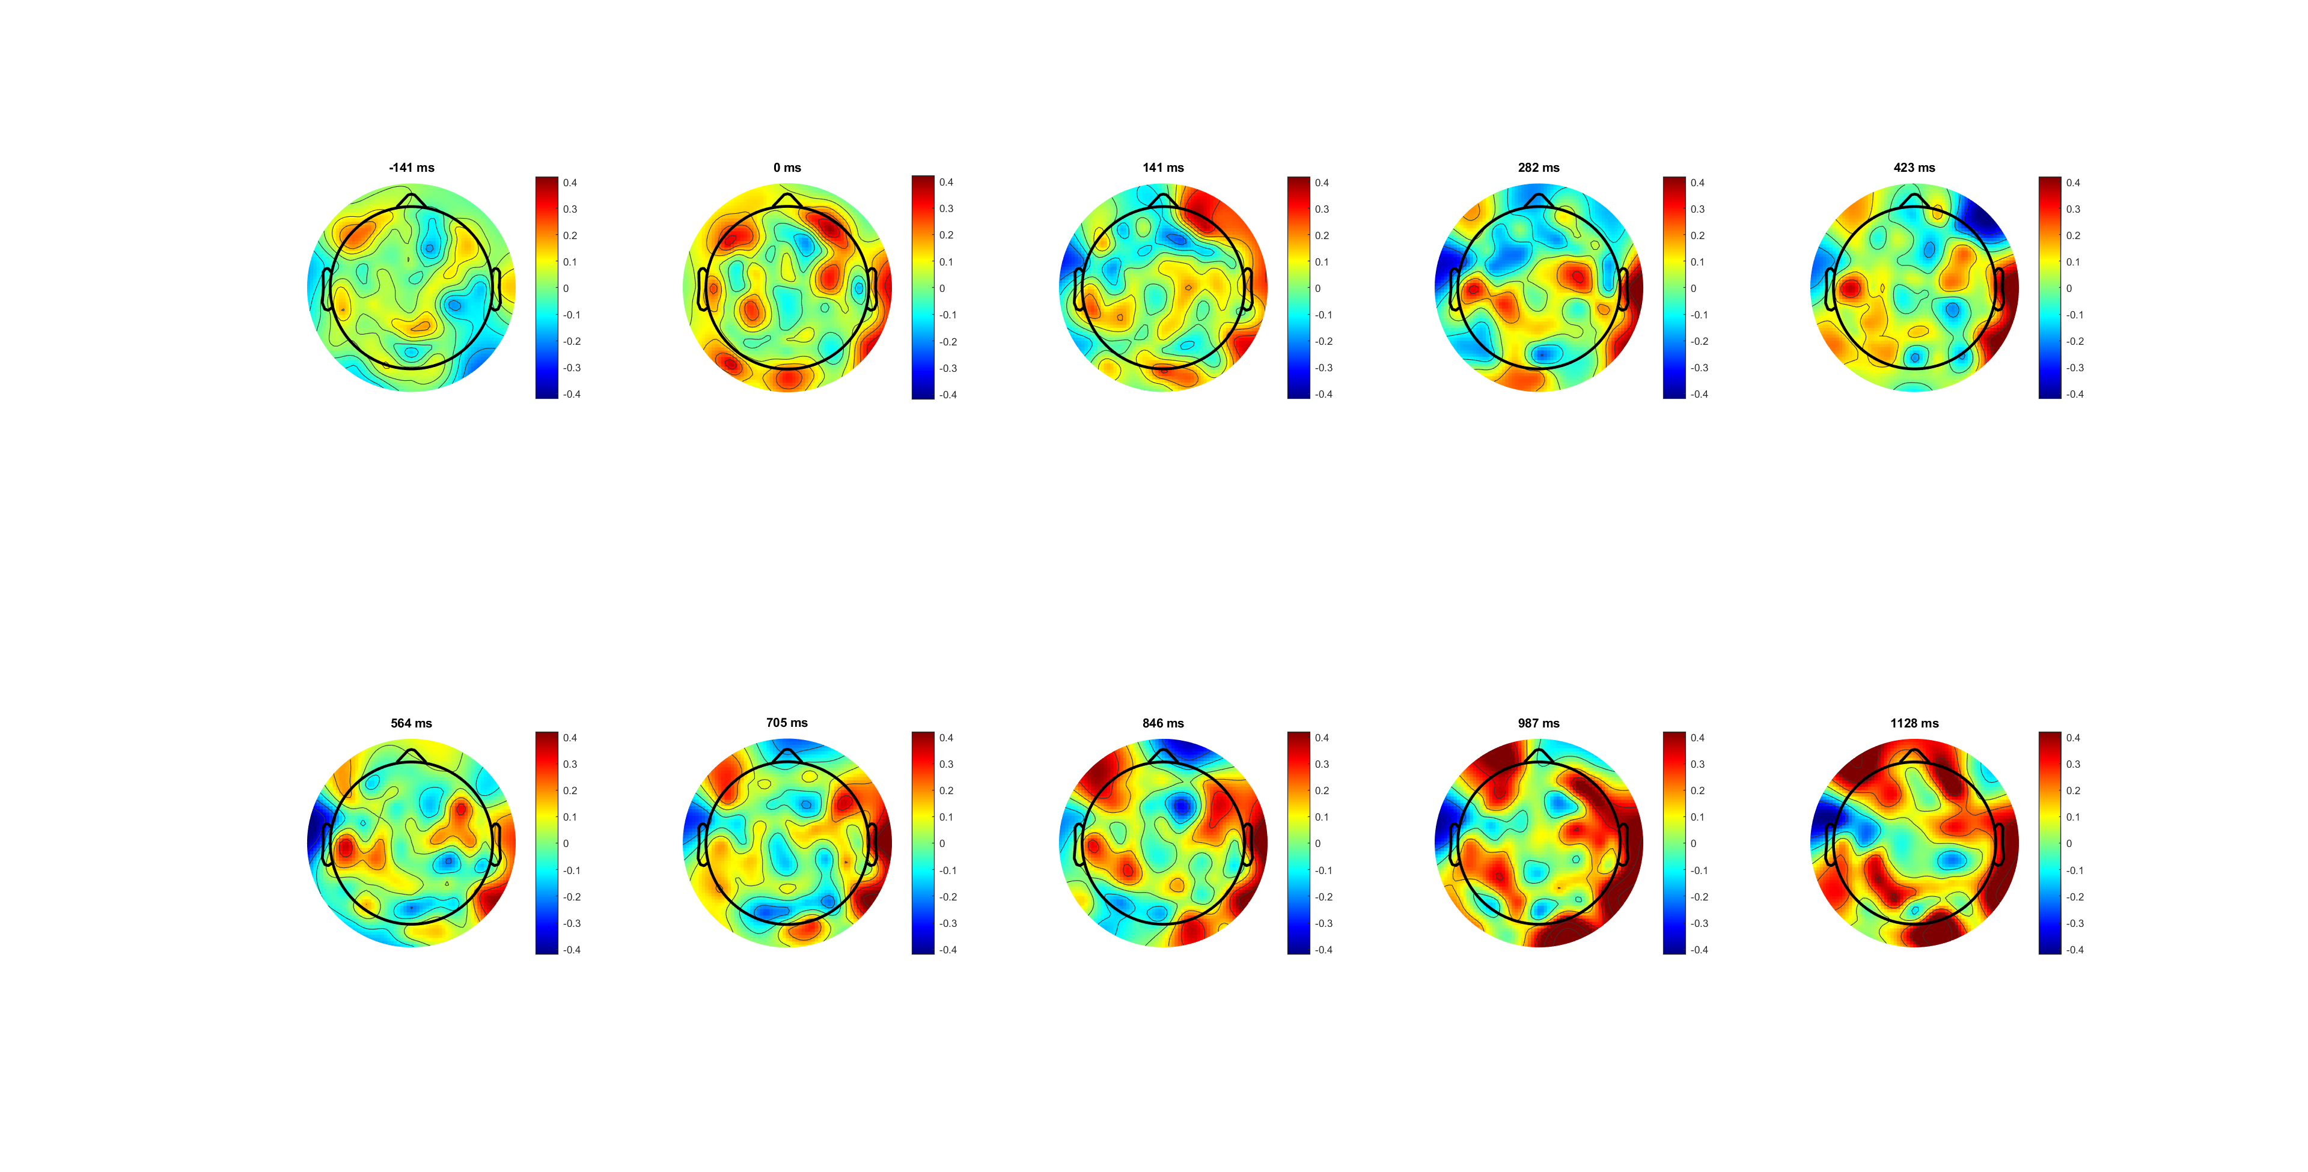
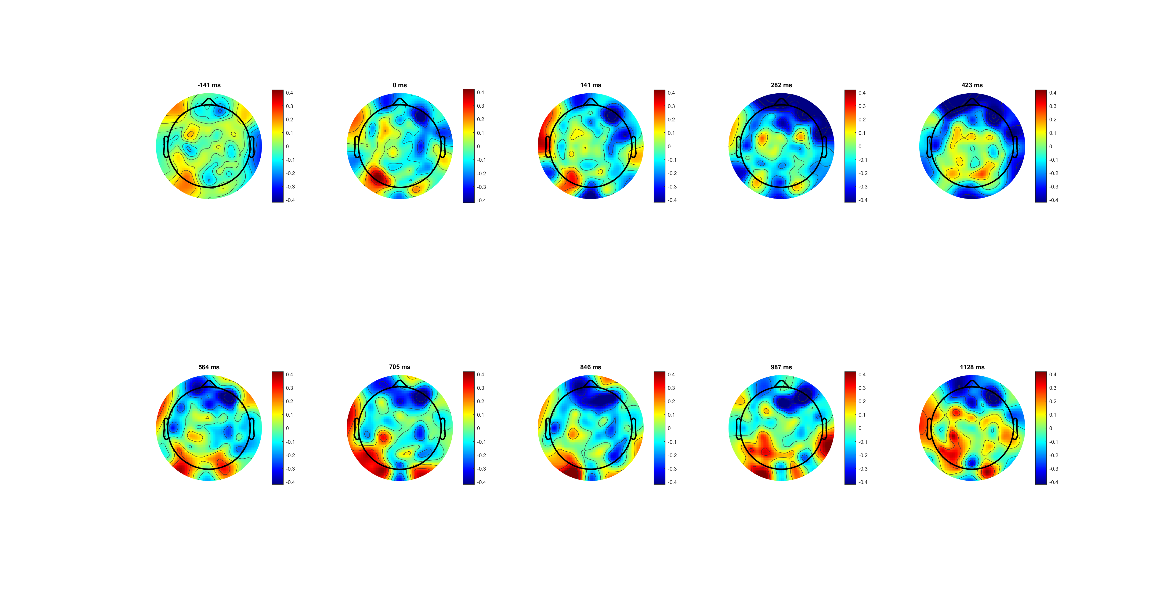



FDI
Because different location
Can’t compare between FDI and BCP using same channel,(better way?)
BCP

Slide 37
FDI (C3/4+) BCP (C3/4+)
The lateralization (left- right) of BCP is more obvious than that of FDI
*muscle amount diff/ control diff

Slide 38
116 55
BCP is in mu /low beta band is higher, and FDI is higher in high beta band

Slide 39


EMG analysis
No low partial EMG bursts in biceps(change of minds)
Lots partial EMG bursts in FDI
BCP bursts faster (lower motor time-MT)
Notes:
4. Less motor execution time for biceps 更快top-down loop and less feedback
5. decision time decrease partially (more simply connection, less sensorimotor integration/feedback loop )
6.for continuous flow, EEG should more related to sensory evidence, and EMG should more related to behaviour results
Distal more complex, more decision process /information processed during the flow
7. From continues flow, boundary may different
边界positive effect， 滚雪球；自我加大，
Read urggency+ Cisek 的paper urgency gating model adding to acc+grows over time+***evency +Leak signal
和 bound一样。 Later is more important
cortious
动态的可以突然加减
不可以取消
Read triger
心理学内核

Slide 40
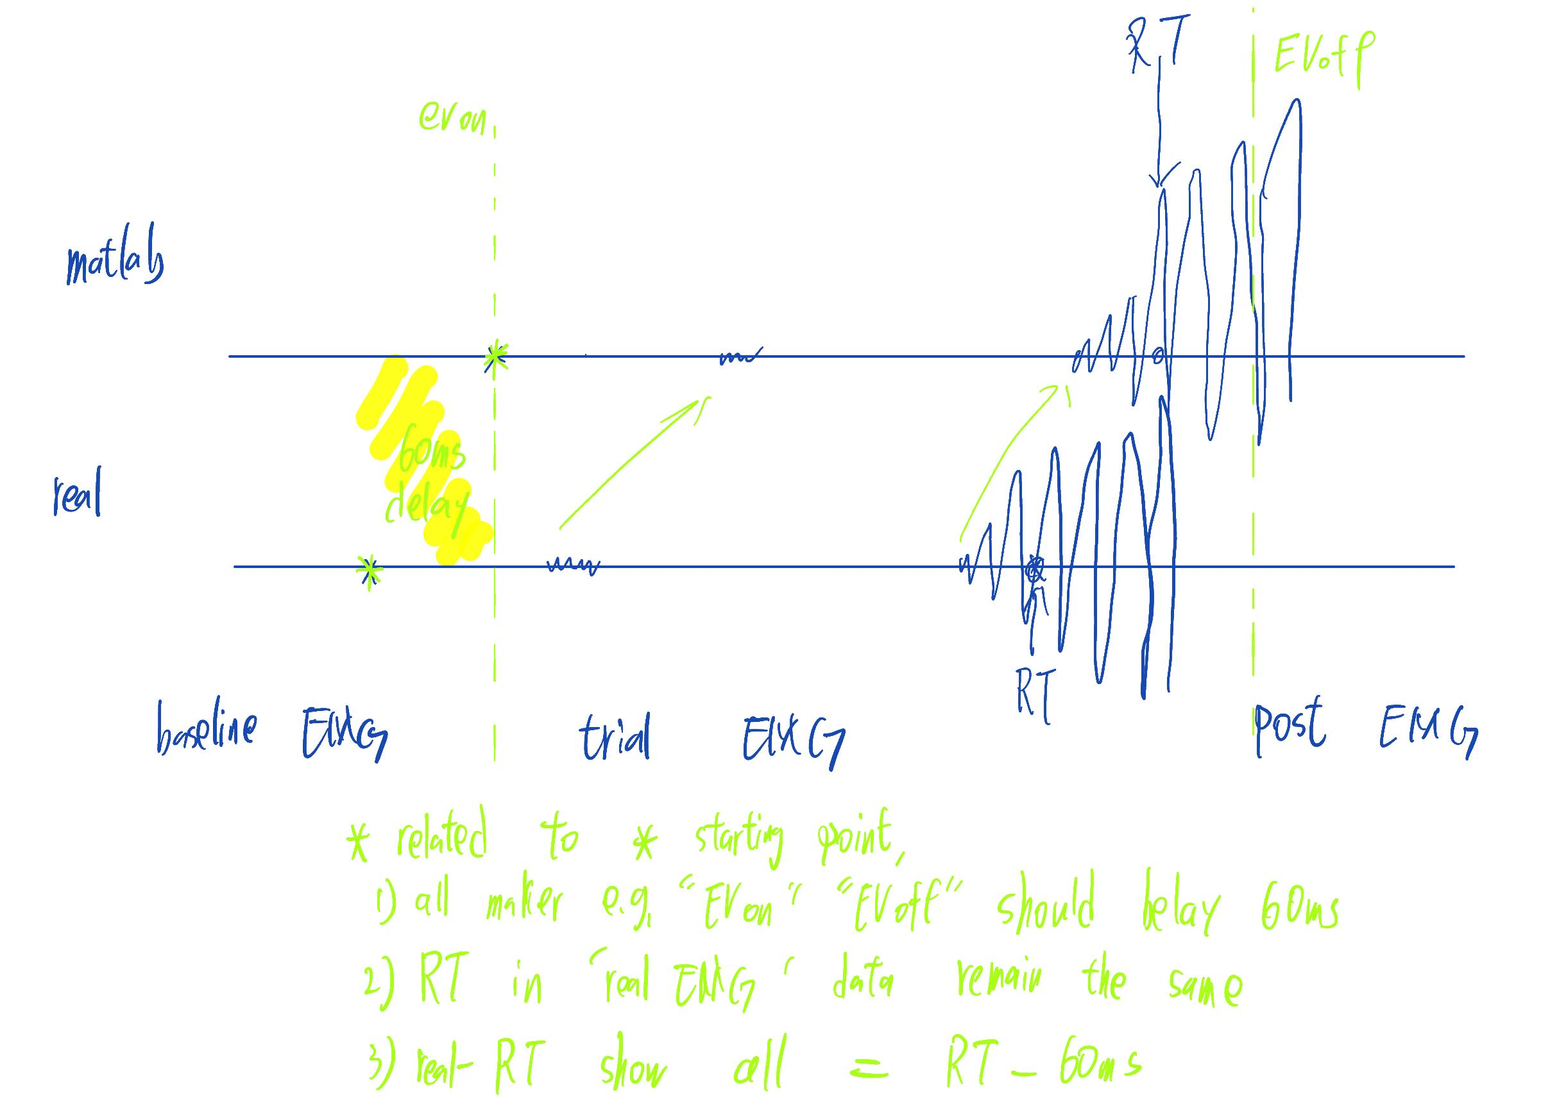
Delay elimination (60-70ms)

Slide 41










Slide 42
The quality of left and right signals and signals from different muscles is different
Right is good
Only analysis right for polit
Findings:
FDI longer motor time (around 100ms)
FDI more partial bursts
BCP almost no partial bursts and peaks faster (around 80ms)
2068 -> sum((movement_counts_right==1 | movement_counts_right==2))
-> sum(movement_counts_left==1 | movement_counts_left==2| movement_counts_left==3)
2583 -> sum(movement_counts_right==0)
4867 -> sum(movement_counts_left==0)

